Slide 1
Theme ‘Black & White’
with judging via a 1-5 point system
by members

Slide 2
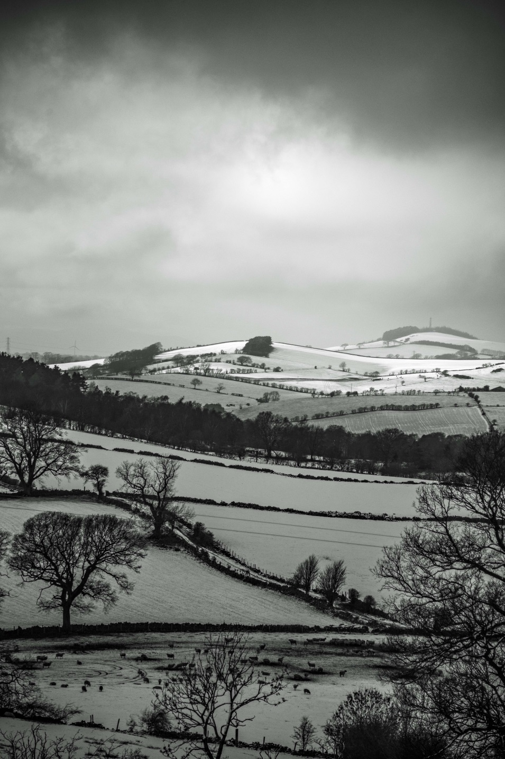
1st – 17 points
‘Bleak mid-winter’ –Jennifer Mackenzie

Slide 3
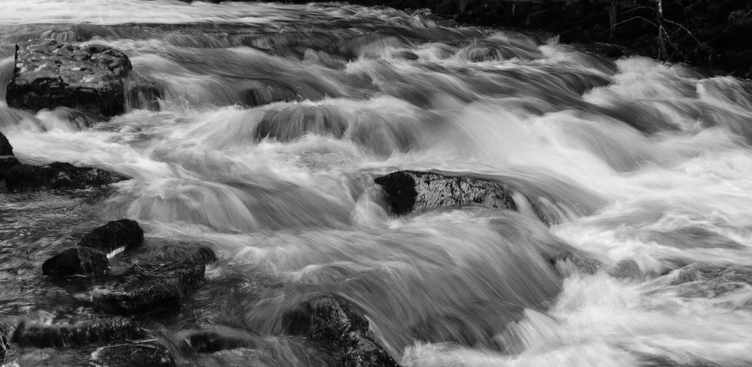
16 points
‘ Ashgill Force’ – Jim Kerr

Slide 4
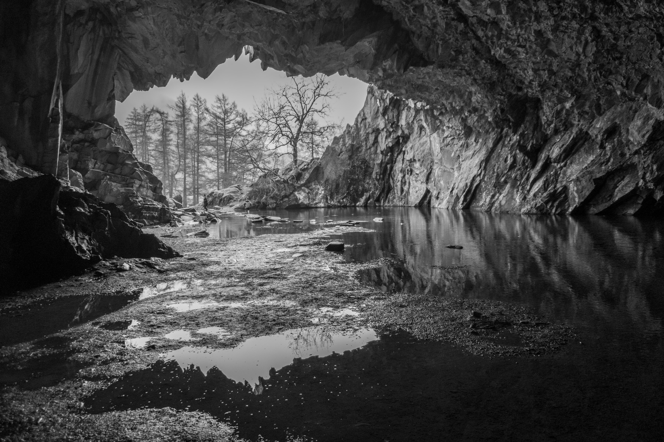
16 points
‘Rydal Water Caves’ –Iain Haley

Slide 5
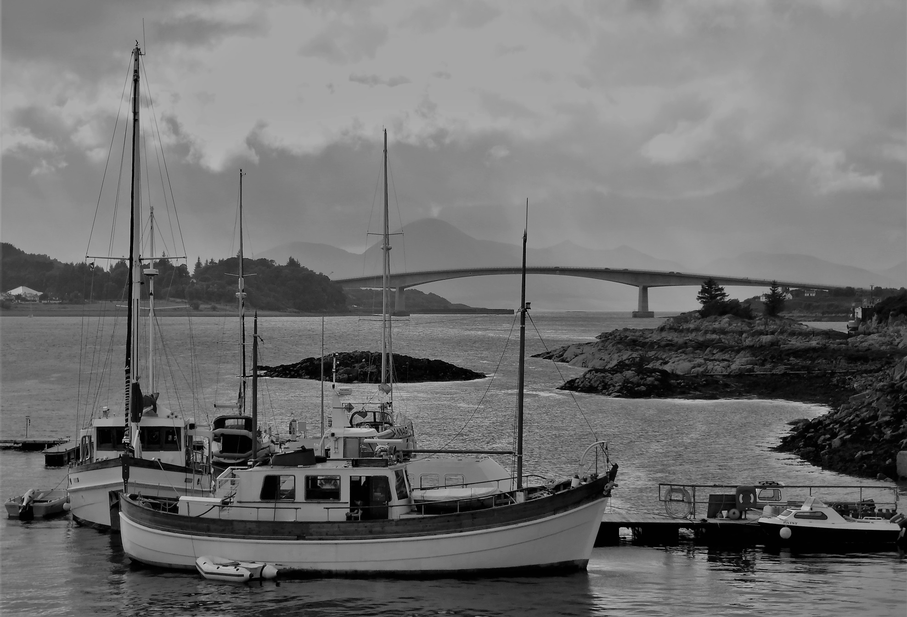
16 points
‘ Skye Transport Systems’ – Andrew Blair

Slide 6
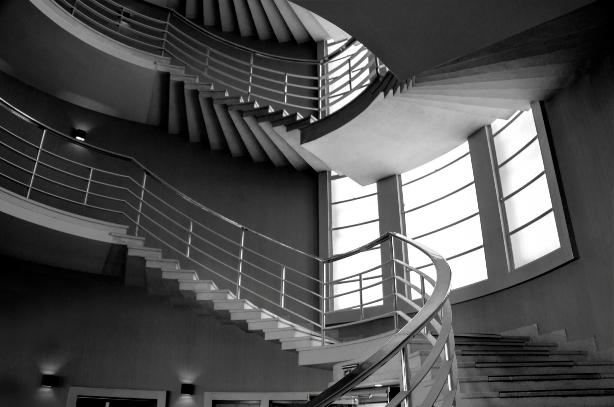
16 points
‘ The Light Source’ – David Bell

Slide 7
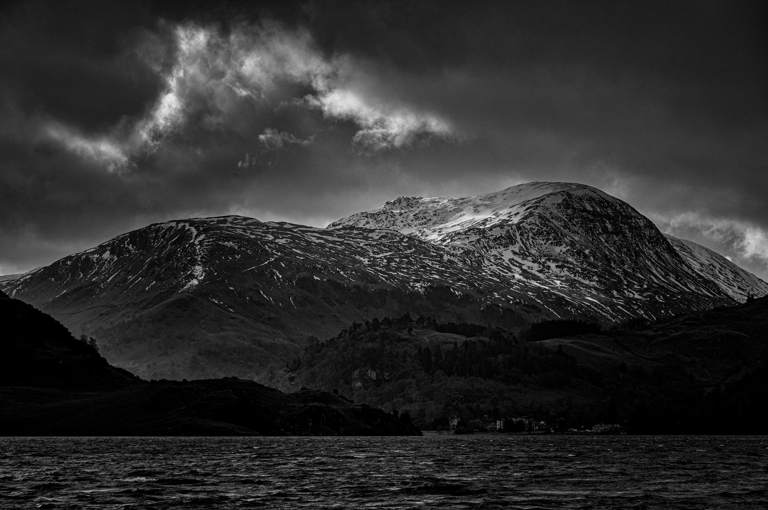
16 points
‘ Ullswater on dark day’ – Barrie Anthony

Slide 8
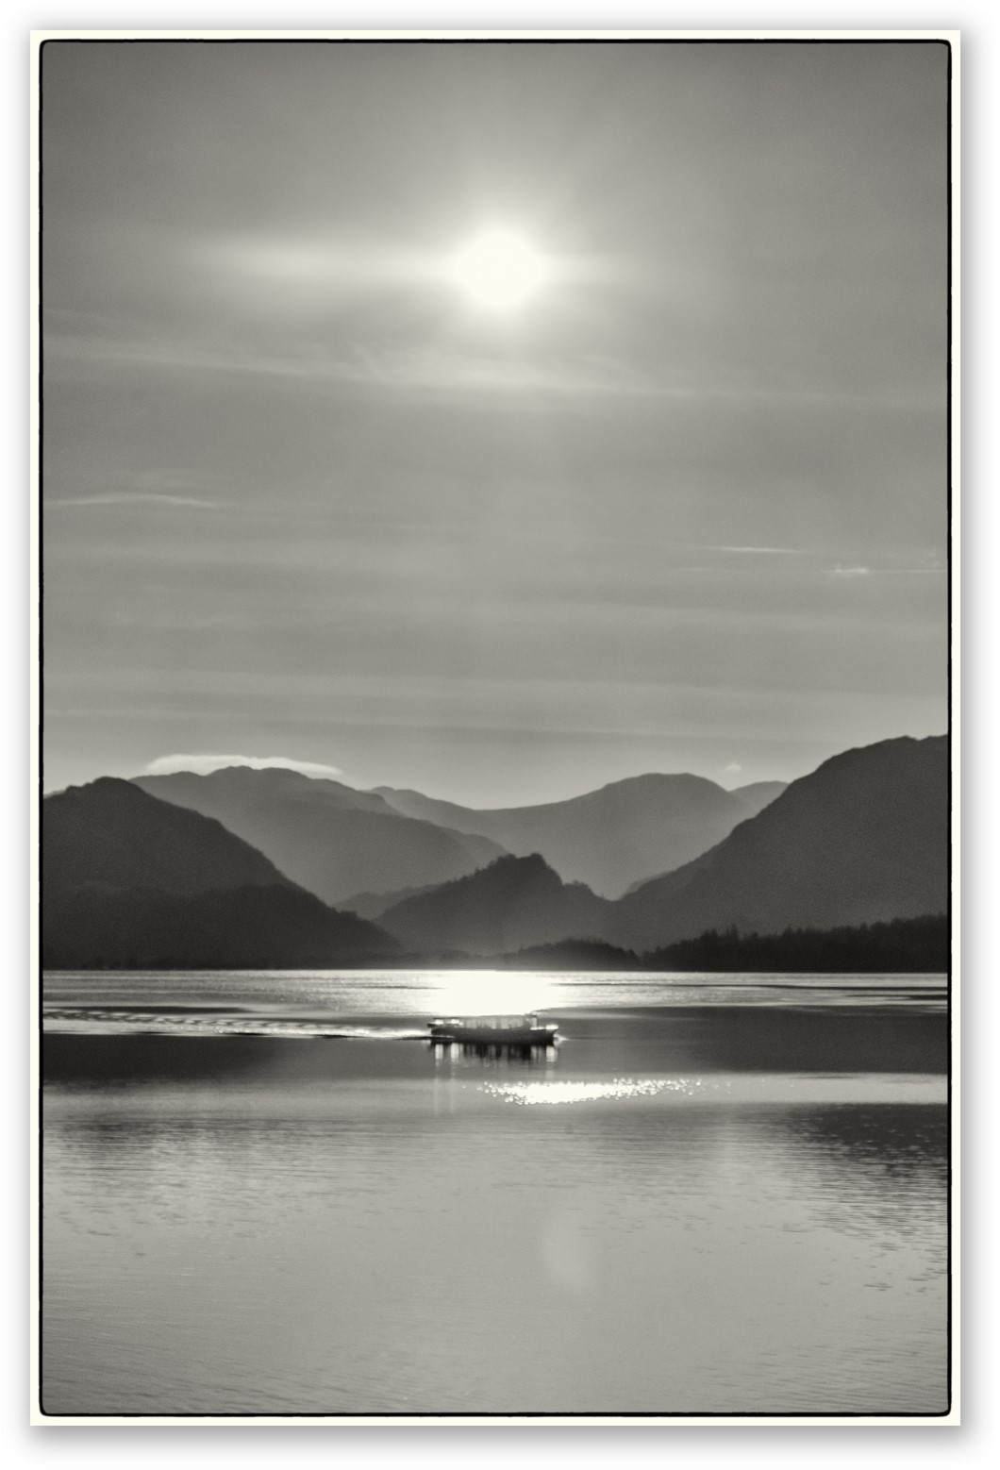
15 points
‘ Steaming Along’ – Michael Holliday

Slide 9
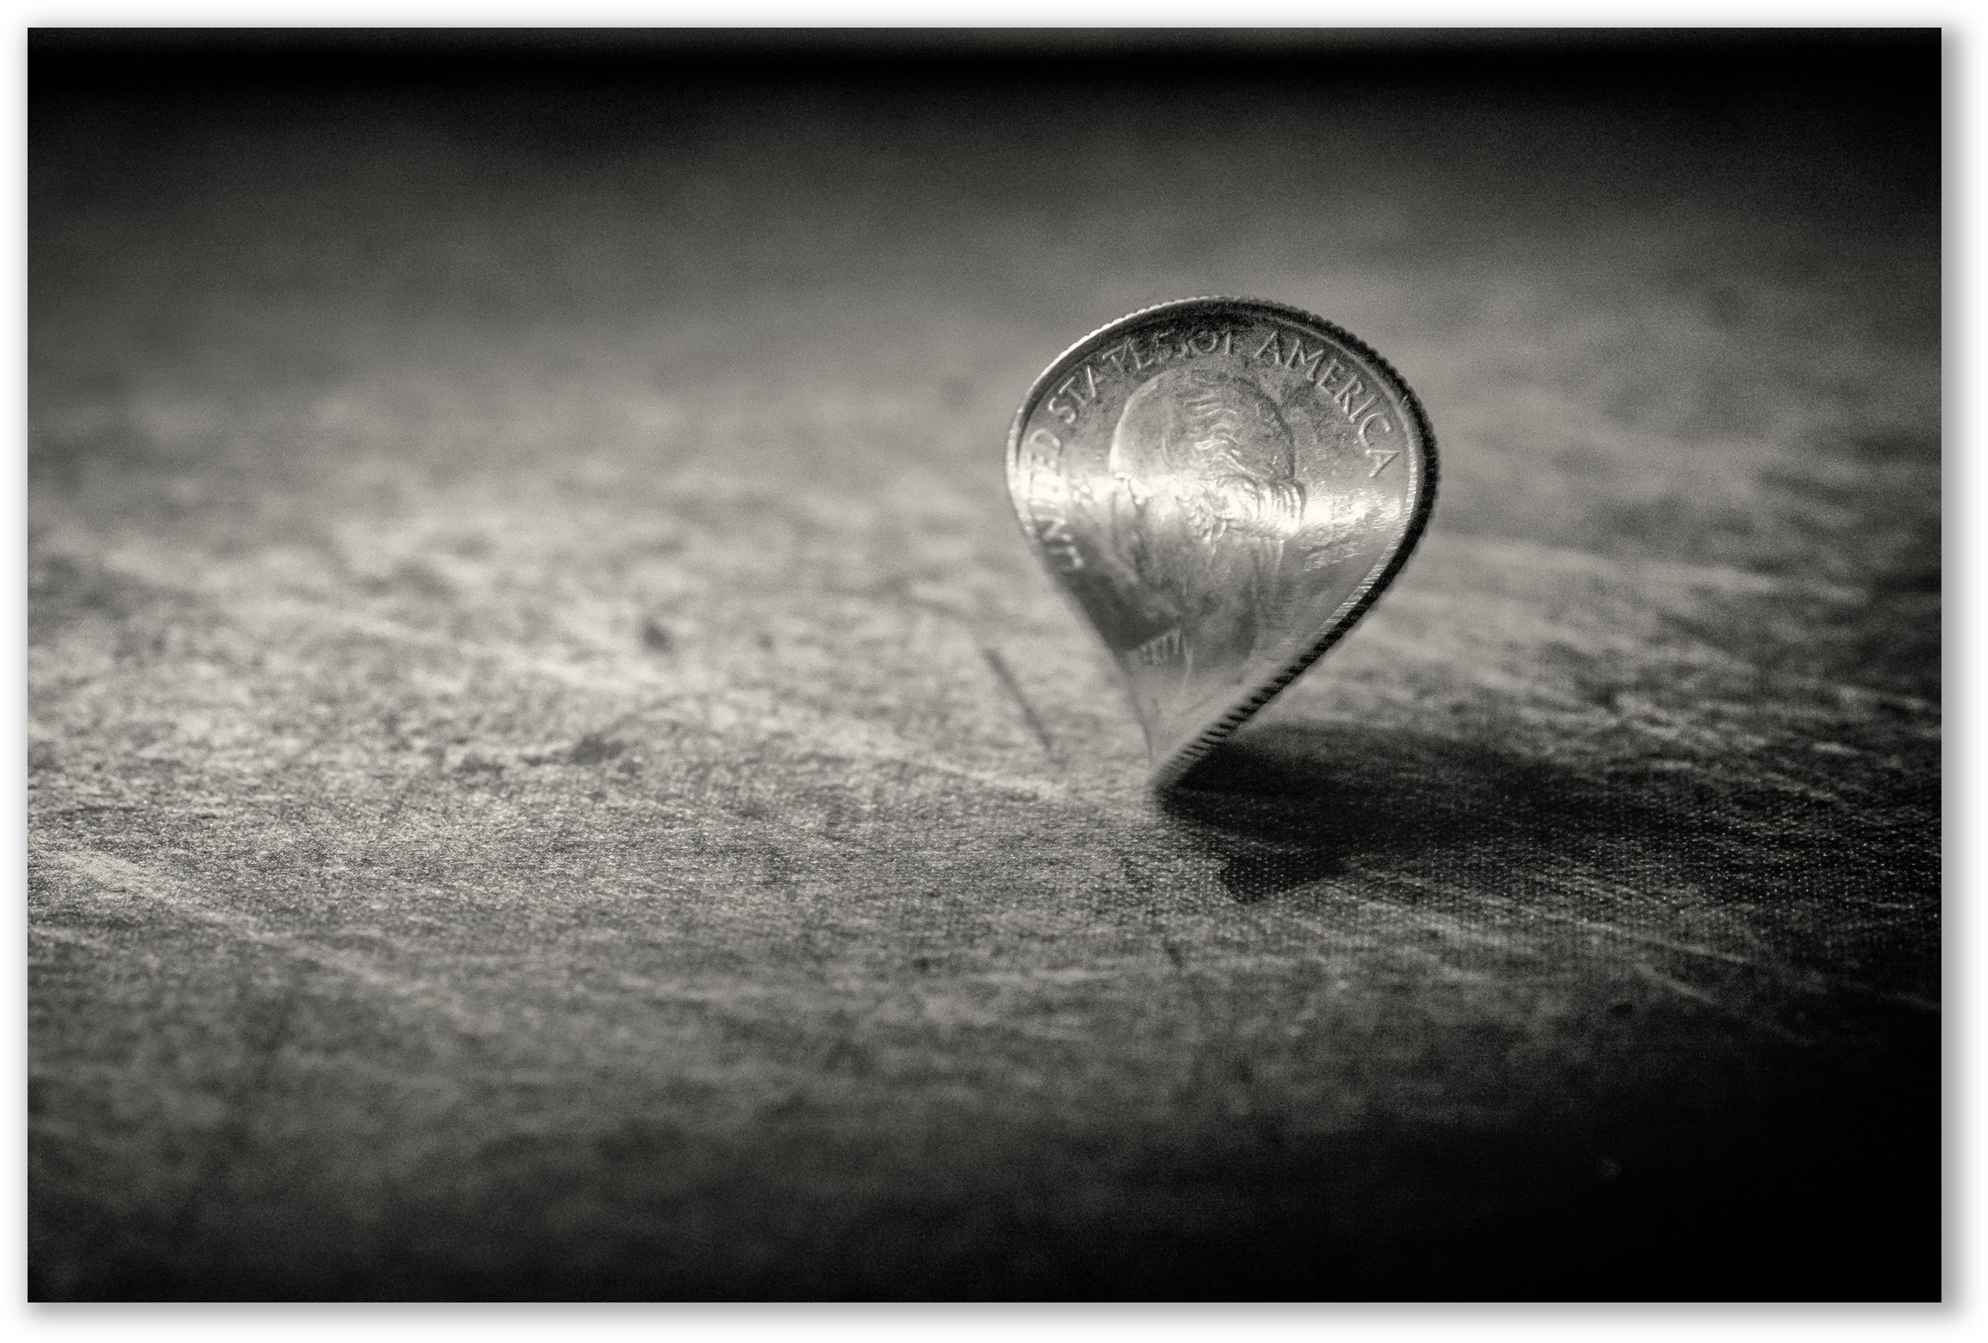
14 points
‘ Coin Spin’ – Michael Holliday

Slide 10
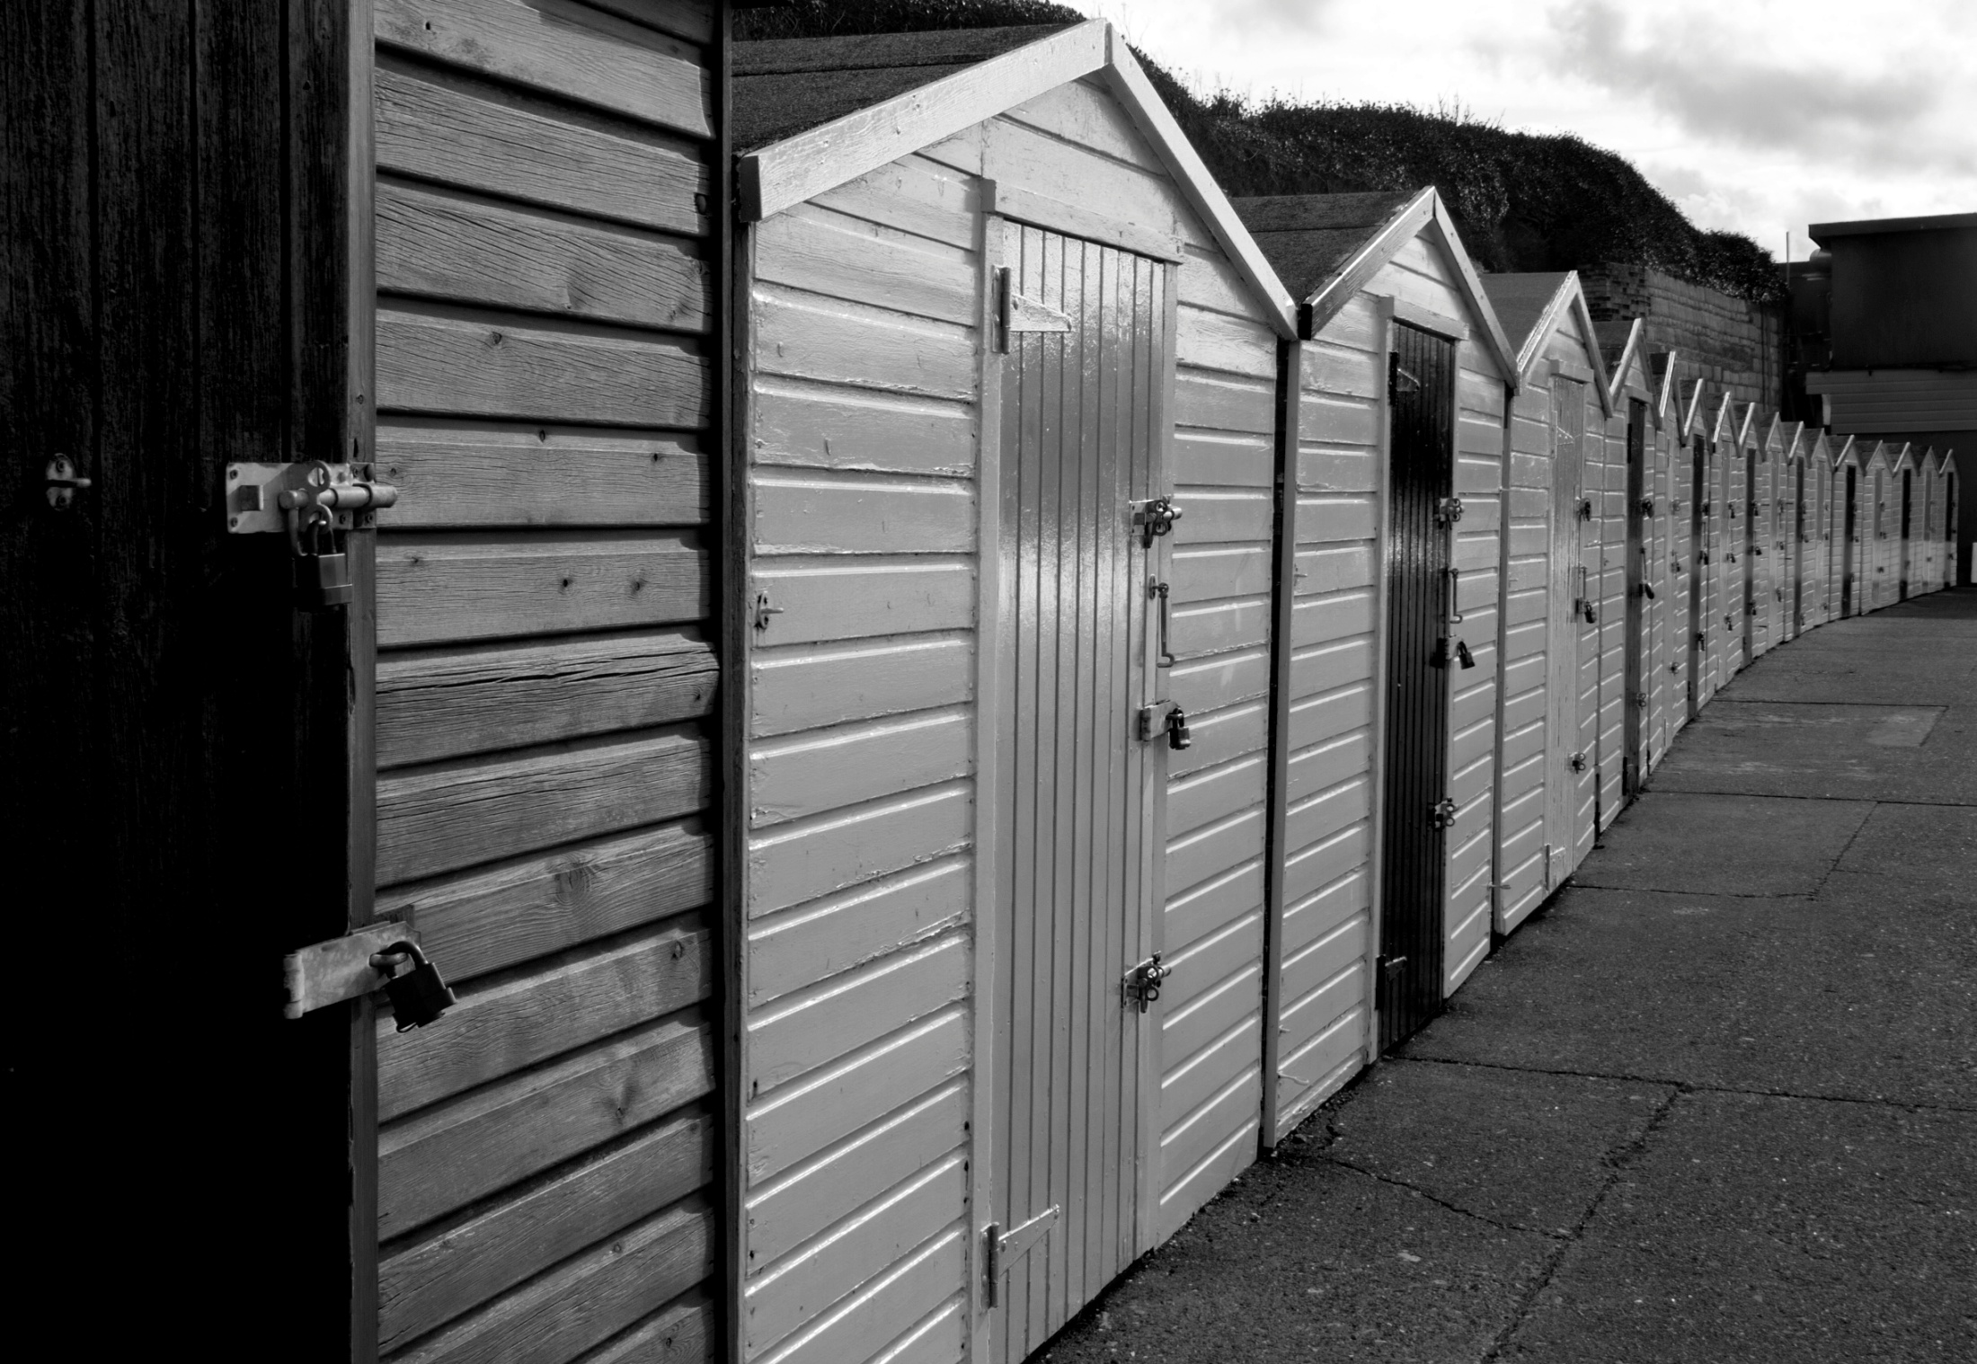
14 points
‘Huts’ – David Bell

Slide 11
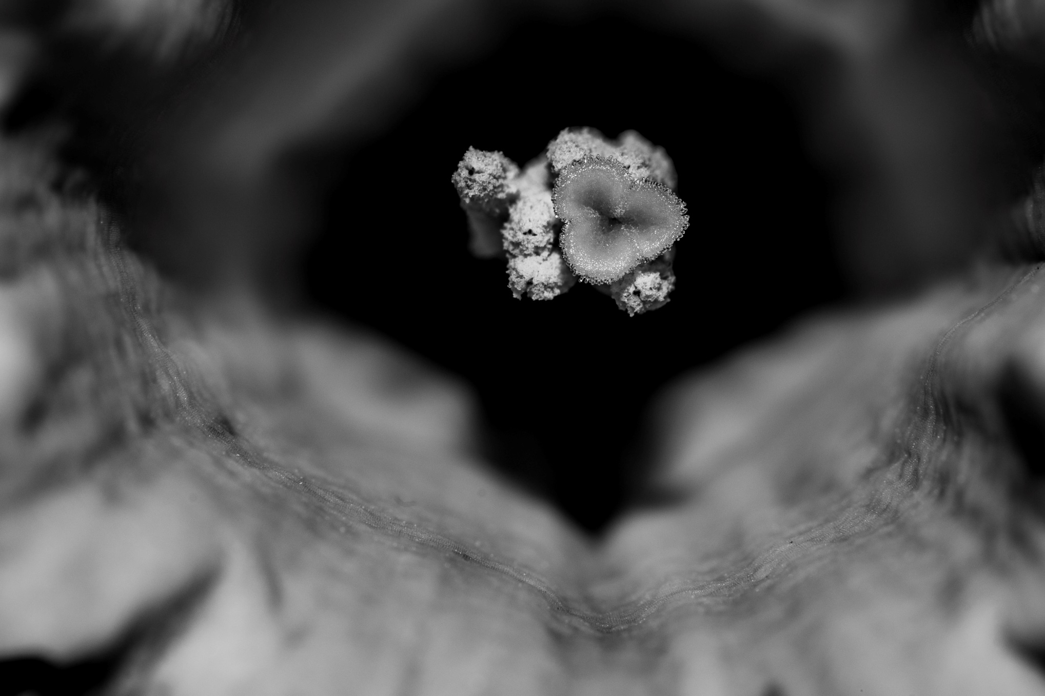
14 points
‘ Daffodil’ Iain Haley

Slide 12
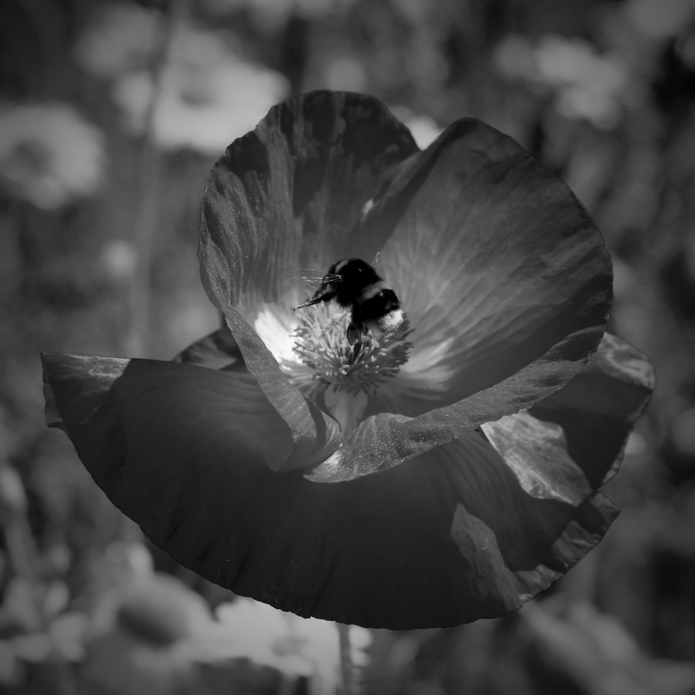
14 points
‘ Snack Time’ – Katie Treave

Slide 13
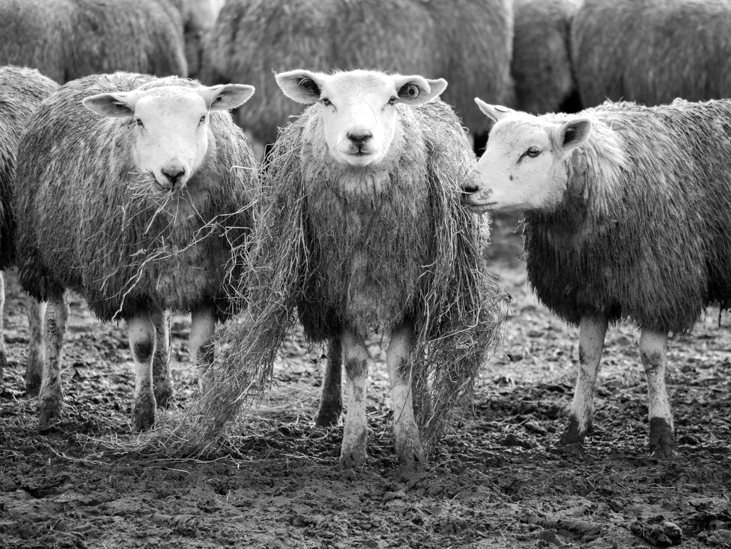
14 points
‘Tear and share scarf’ – Jacqueline Alexander

Slide 14
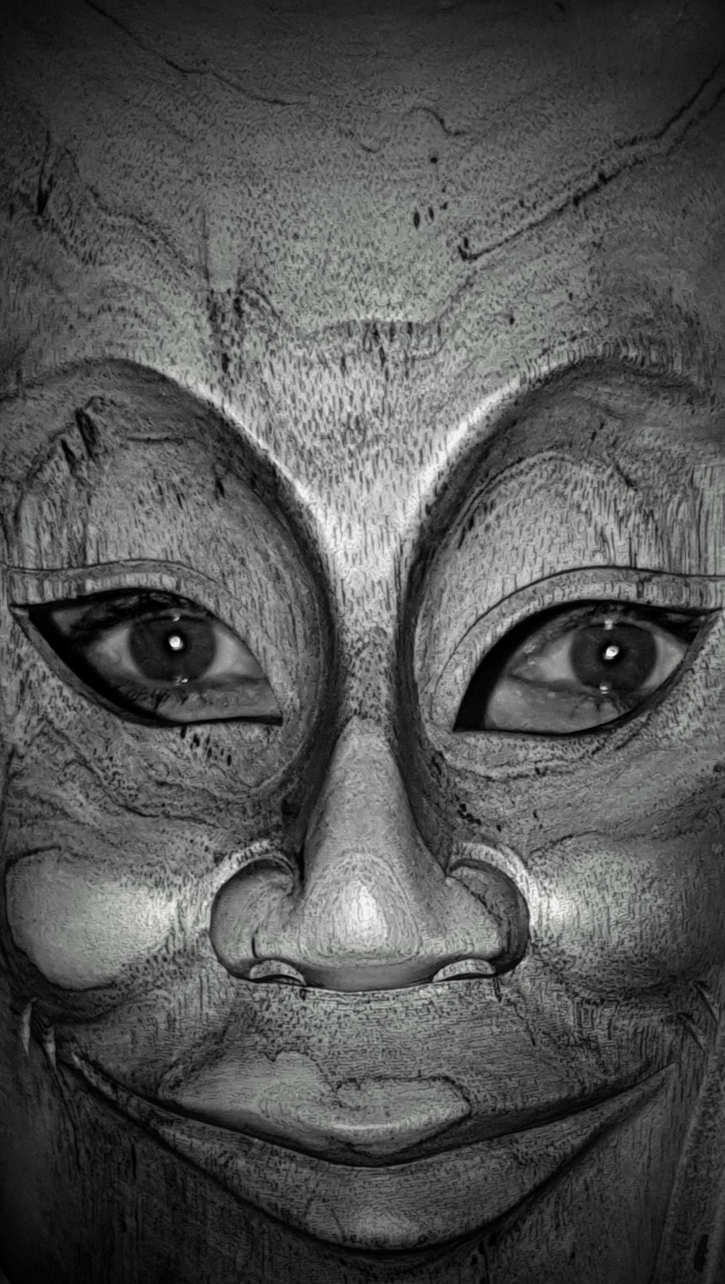
14 points
‘ The Man in the Mask’ – Iain Haley

Slide 15
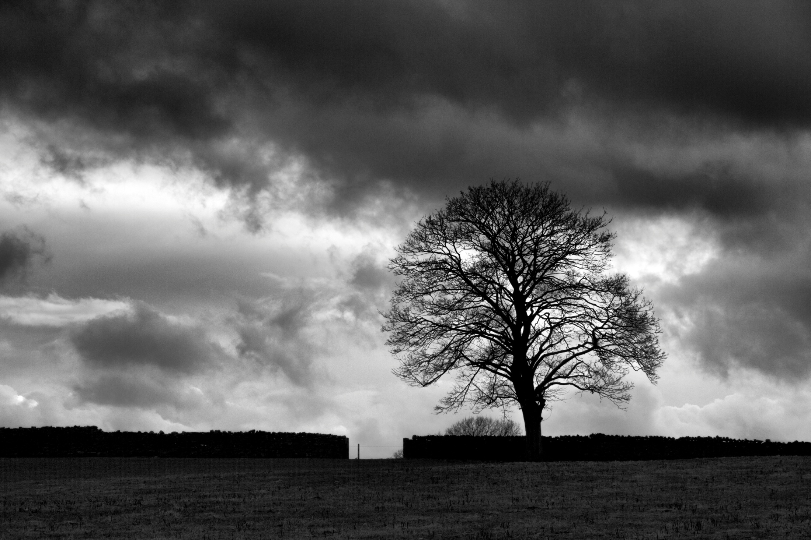
14 points
‘ Tree against a stormy sky’- Jill Eastham

Slide 16
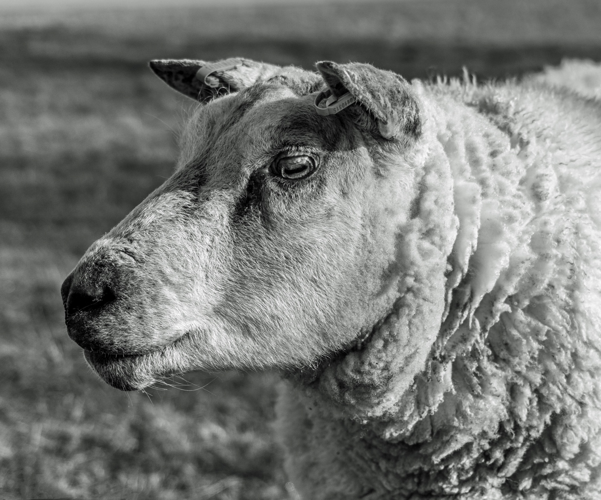
12 points
‘ Baa, baa black & white sheep’-Jennifer Mackenzie

Slide 17
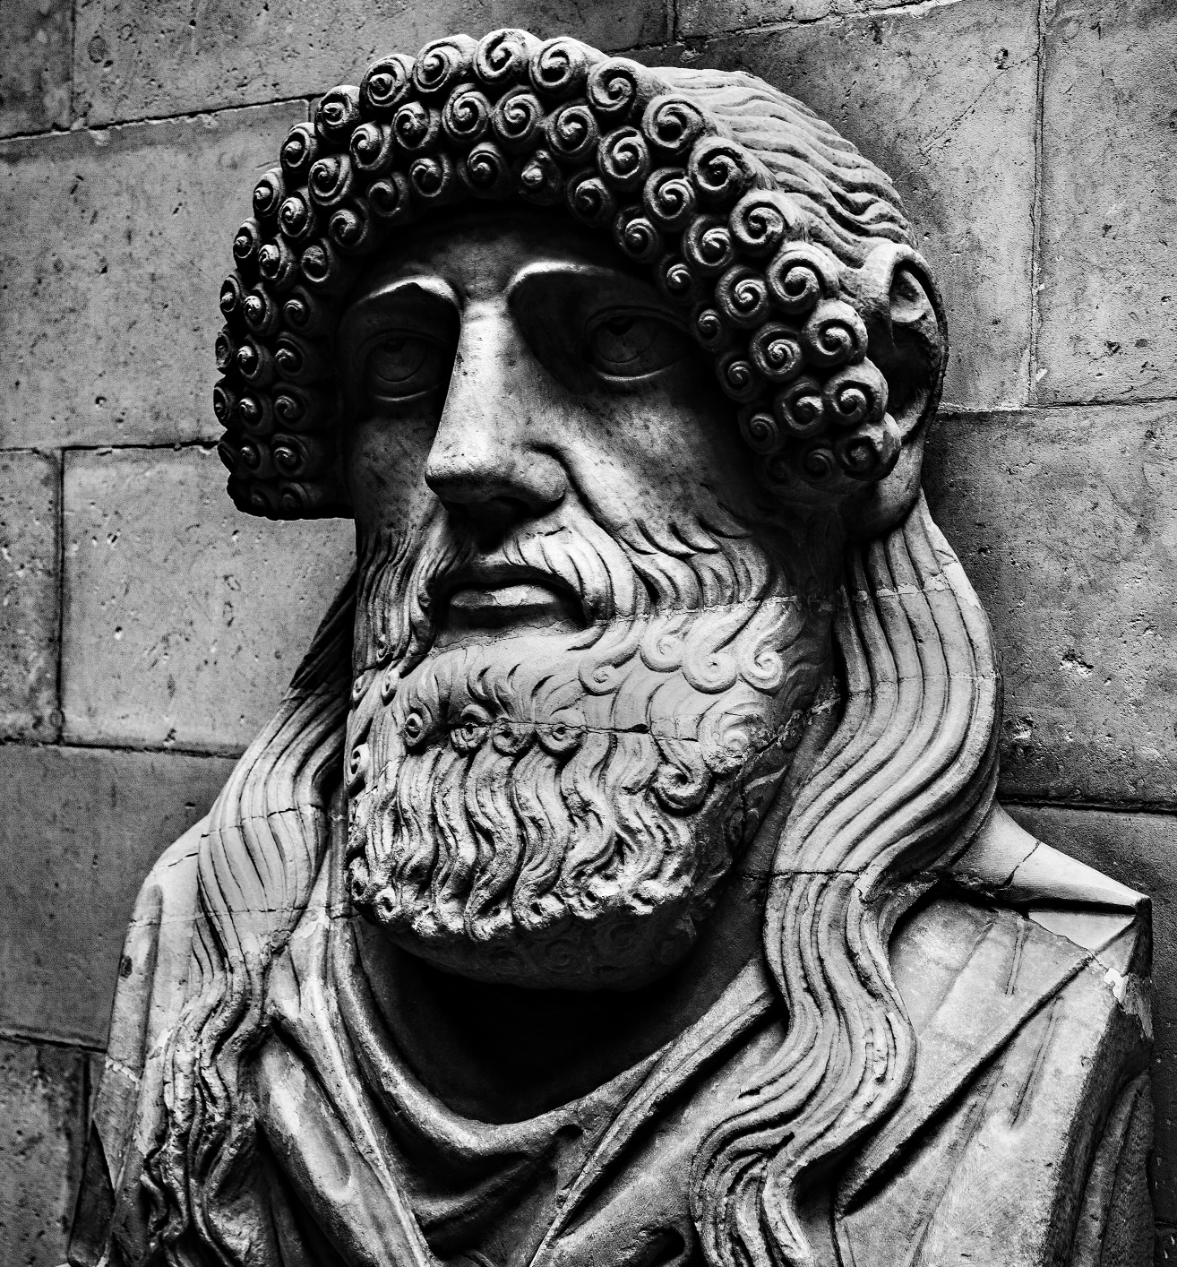
13 points
‘ Been busted’ – Mike Childs

Slide 18
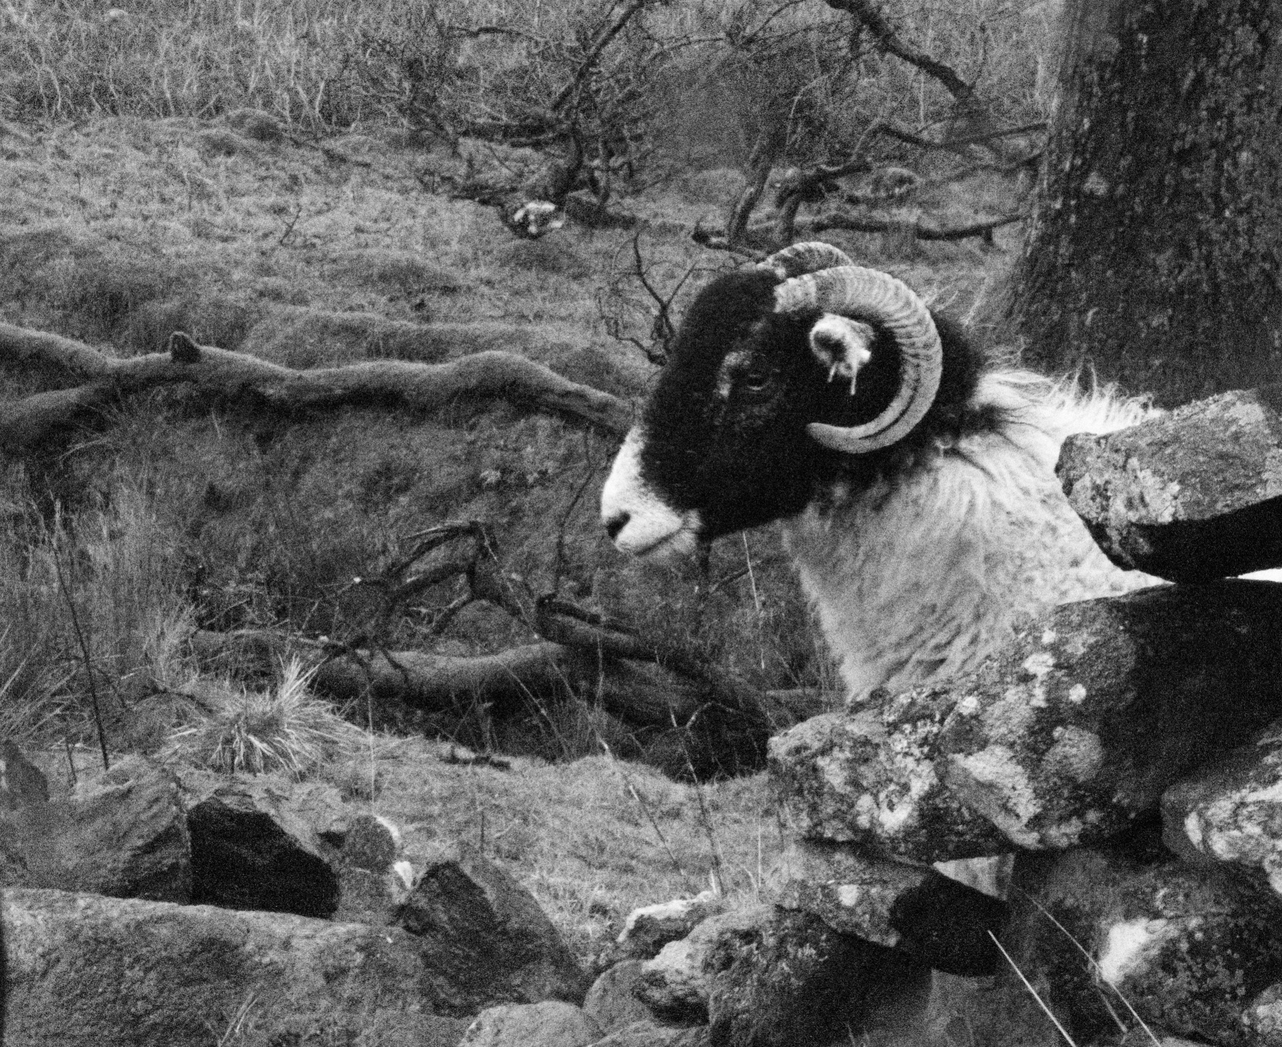
11 points
‘Blackface’ –Colin Bryce

Slide 19
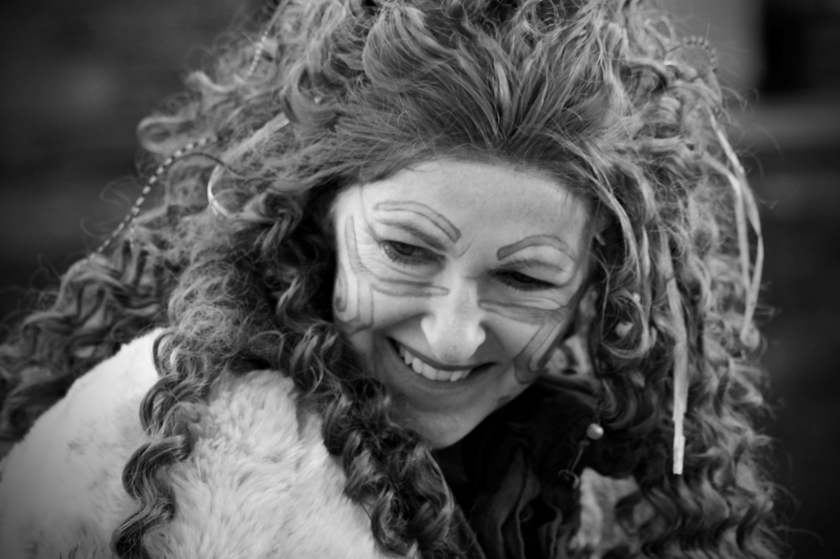
12 points
‘ Boudicca’- Katie Treave

Slide 20
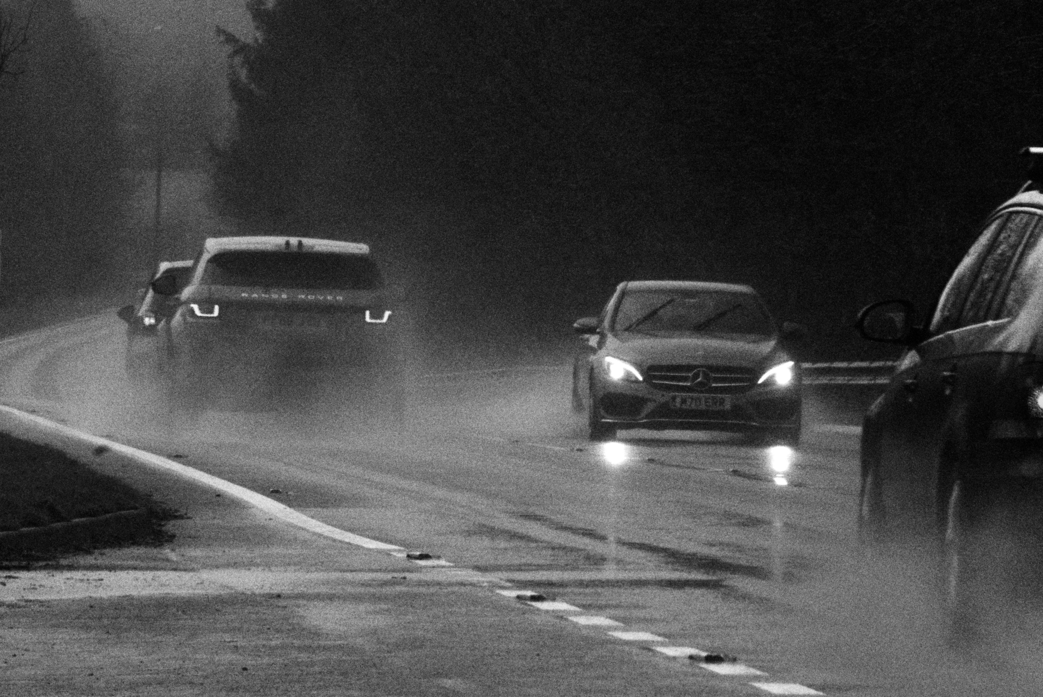
10 points
‘ Cars in the rain’ –Colin Bryce

Slide 21
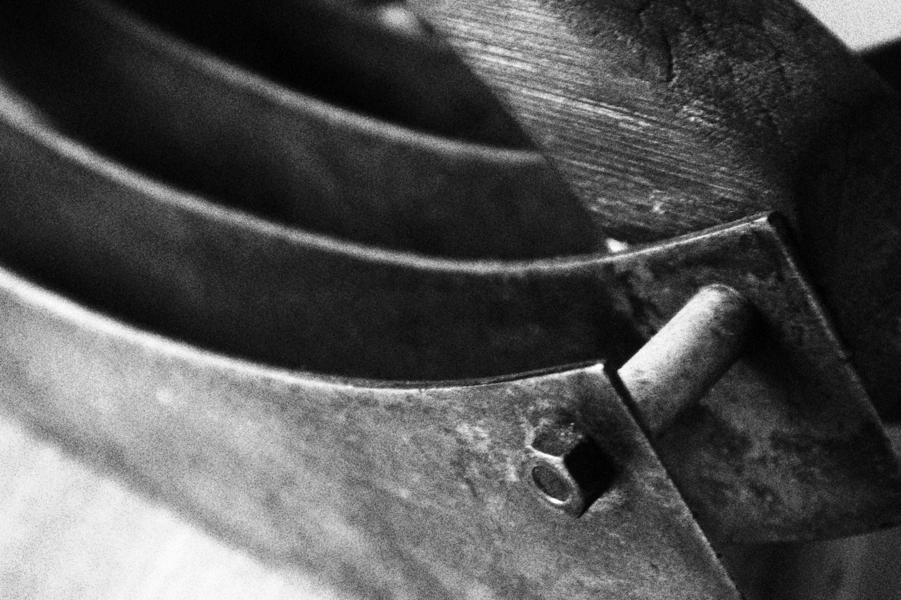
8 points
‘ Chopper ’ – Barbara Keen

Slide 22
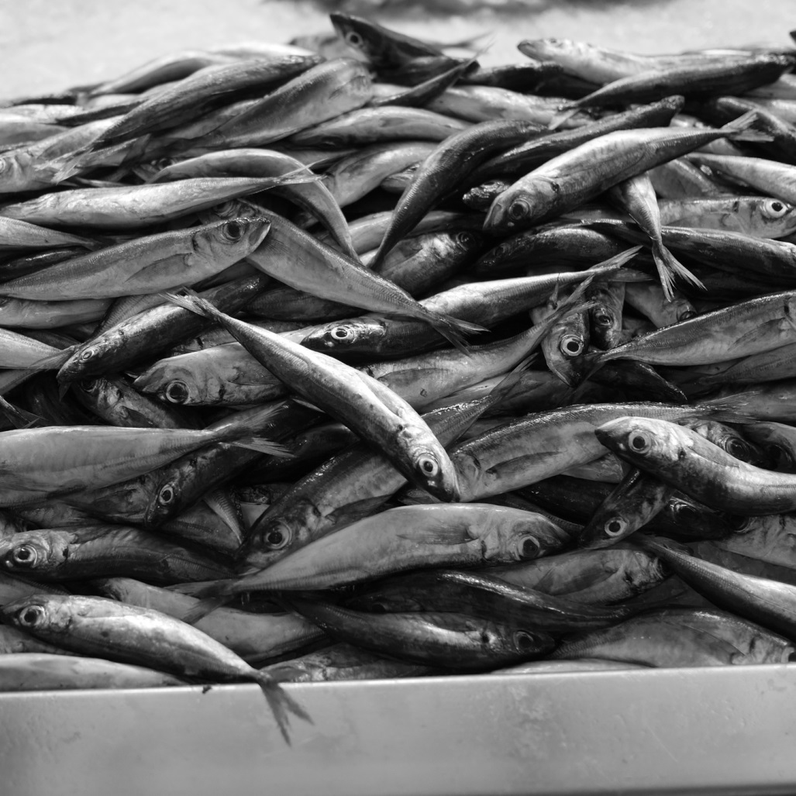
13 points
‘ Day’s catch’ – Dennis Butterworth

Slide 23
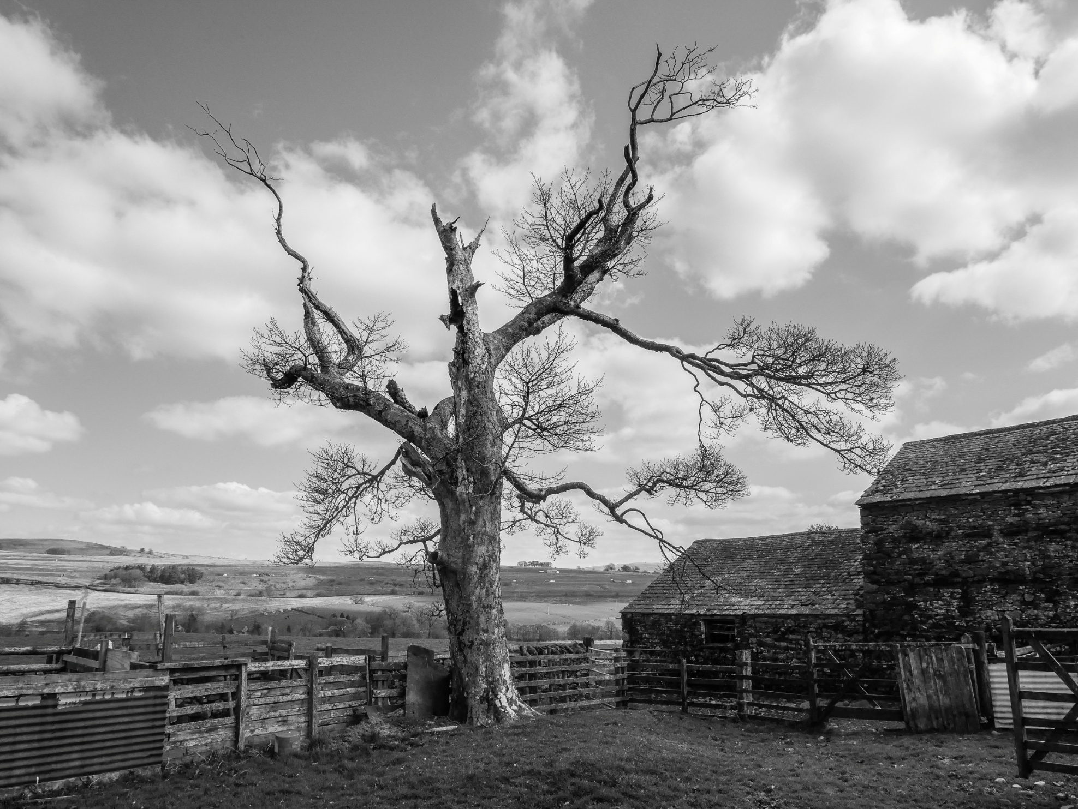
12 points
‘ Dead wonky tree’ – Jacqueline Alexander

Slide 24
13 points
‘ Duchess Razor’ –Colin Bryce

Slide 25
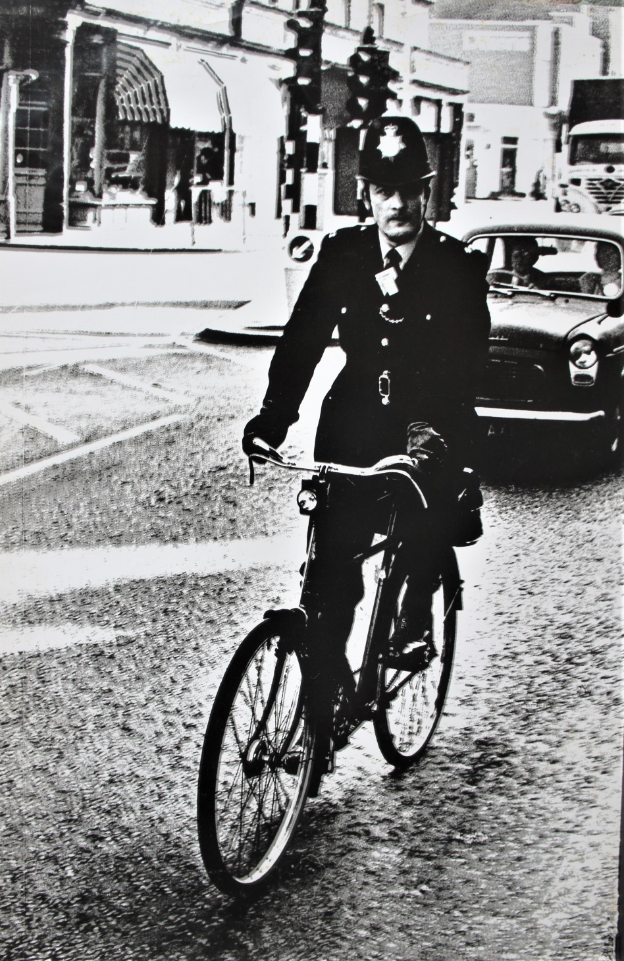
10 points
‘ Evening Al-Donals’ –Donald McLellan

Slide 26
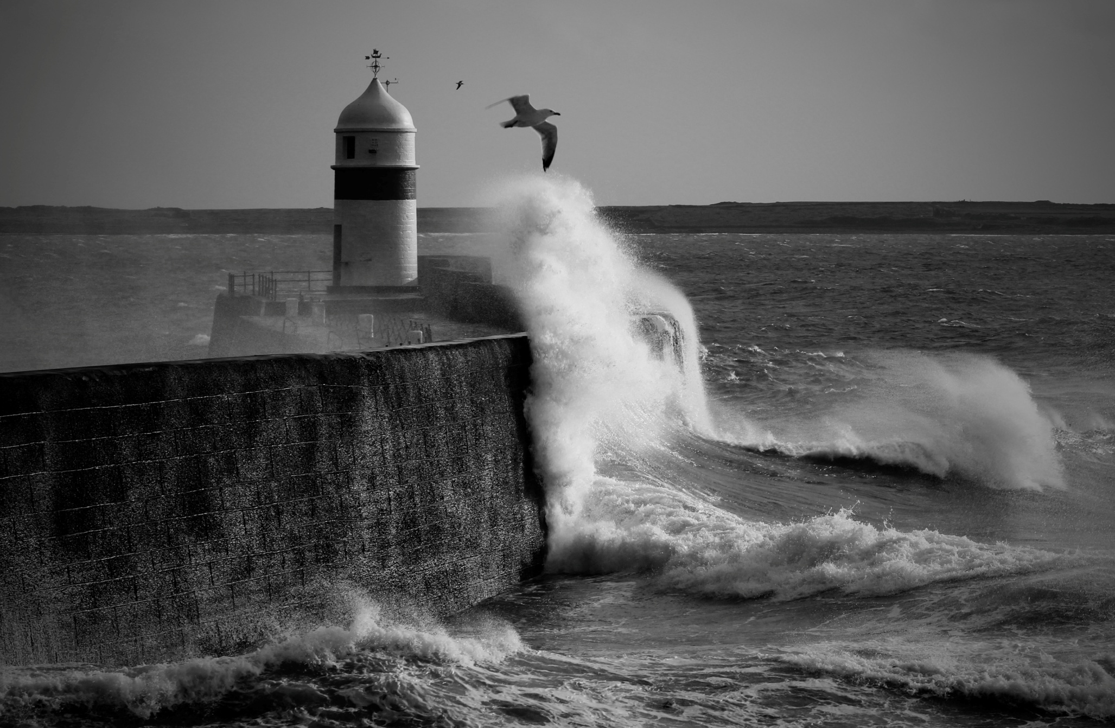
13 points
‘ Facing the Storm’ –Katie Treave

Slide 27
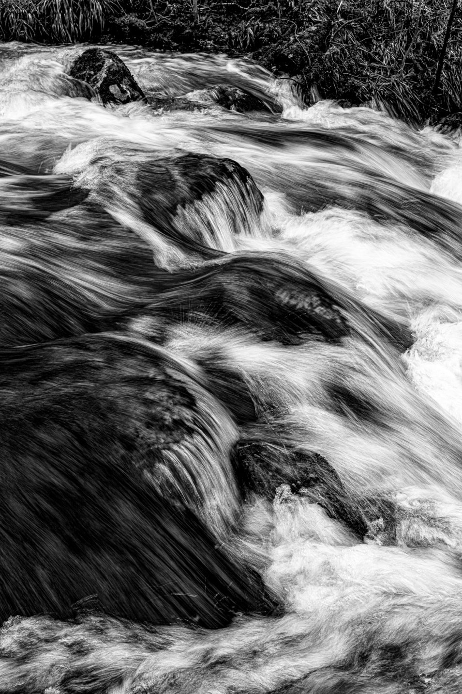
10 points
‘Fast water in Aira creek’ – Barrie Anthony

Slide 28
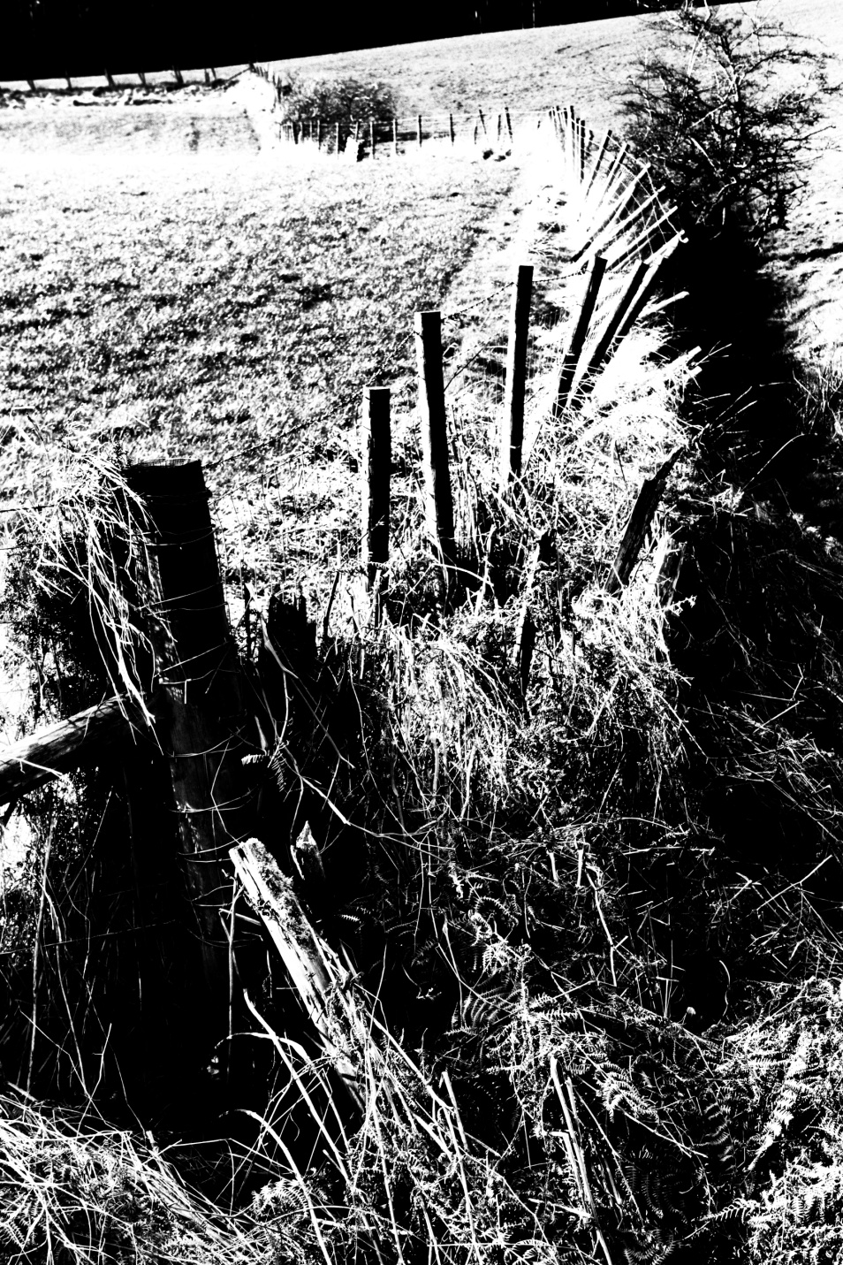
8 points
‘Fence Line’ –Jill Eastham

Slide 29
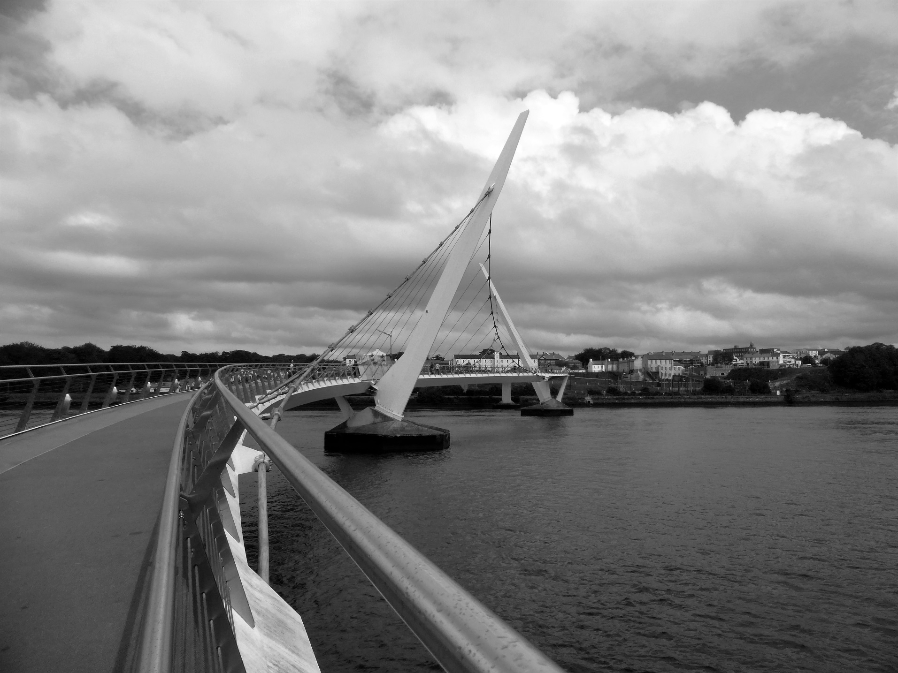
11 points
‘Hands across the water’ – Andrew Blair

Slide 30
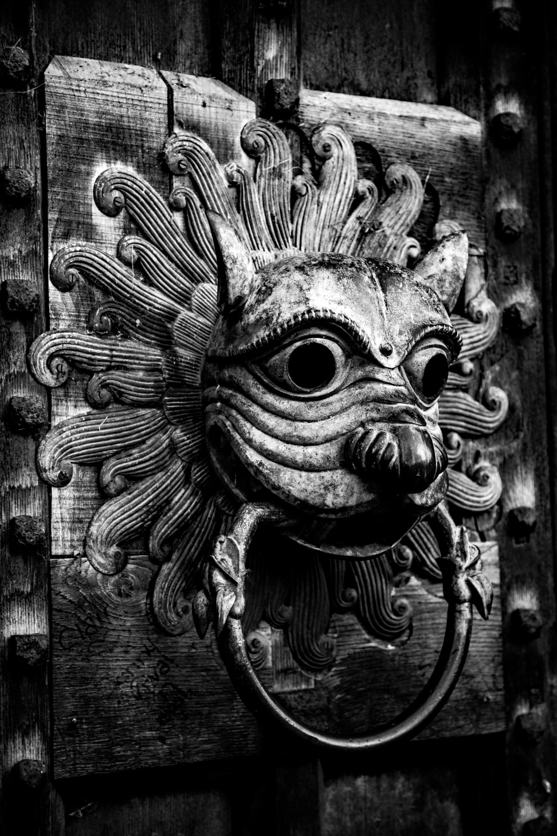
12 points
‘Knock, knock’ –Mike Childs

Slide 31
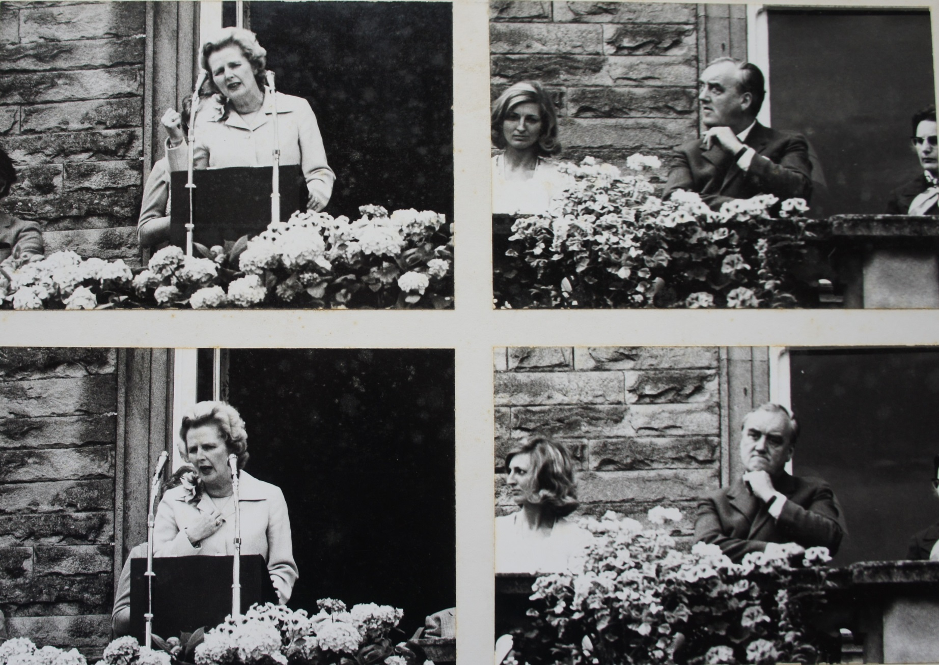
9 points
‘Maggie’- Donald McLennan

Slide 32
4 points
‘Raw Power’ –Dennis Butterworth

Slide 33
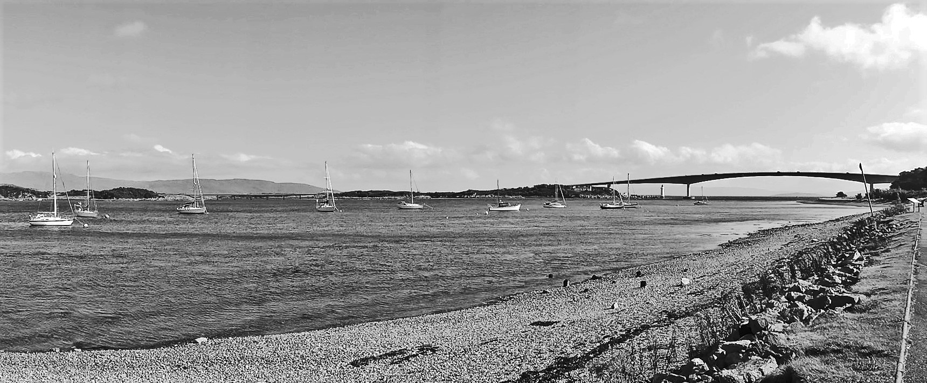
10 points
‘Road to the Isles’ –Andrew Blair

Slide 34
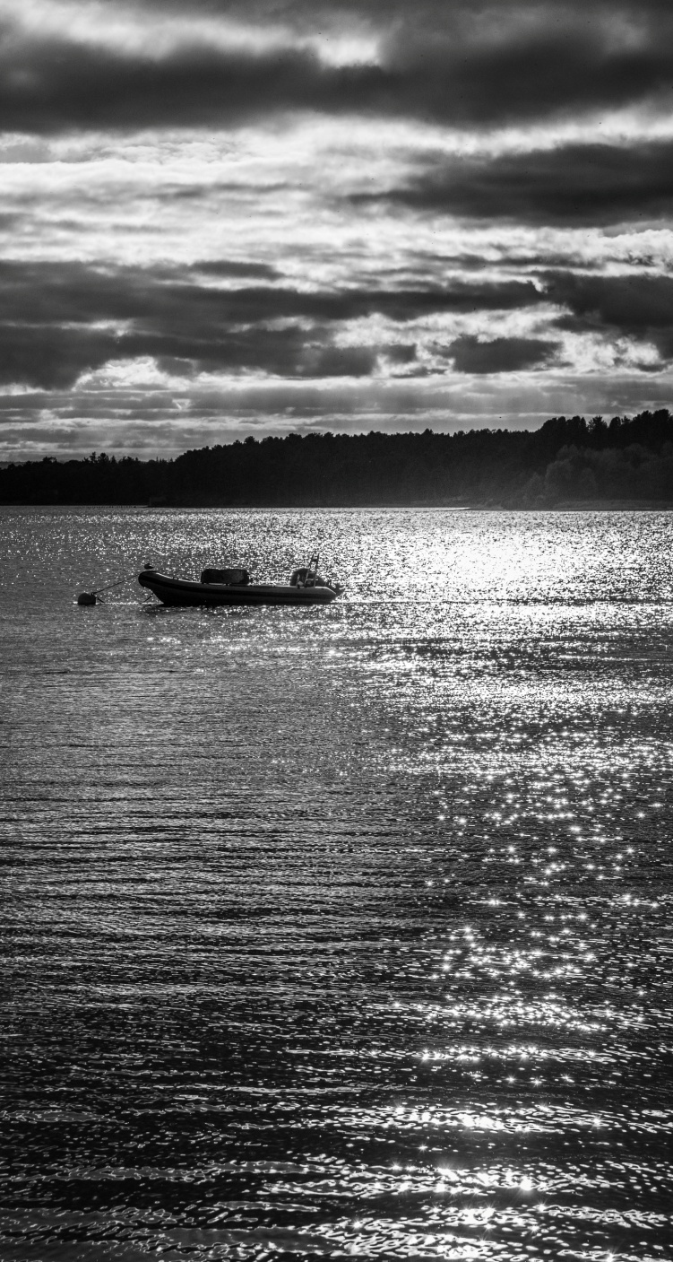
10 points
‘ Silver Waters’ – Jennifer Mackenzie

Slide 35
10 points
‘ Spring is near’- Dennis Butterworth

Slide 36
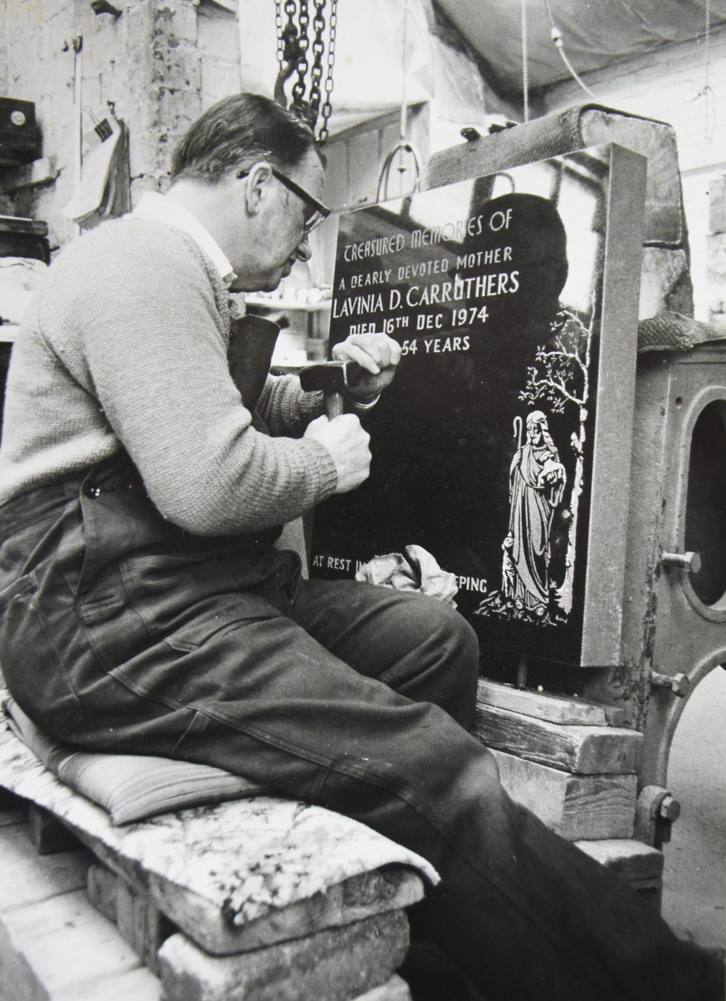
10 points
‘ Stonemason’ – Donald Maclennan

Slide 37
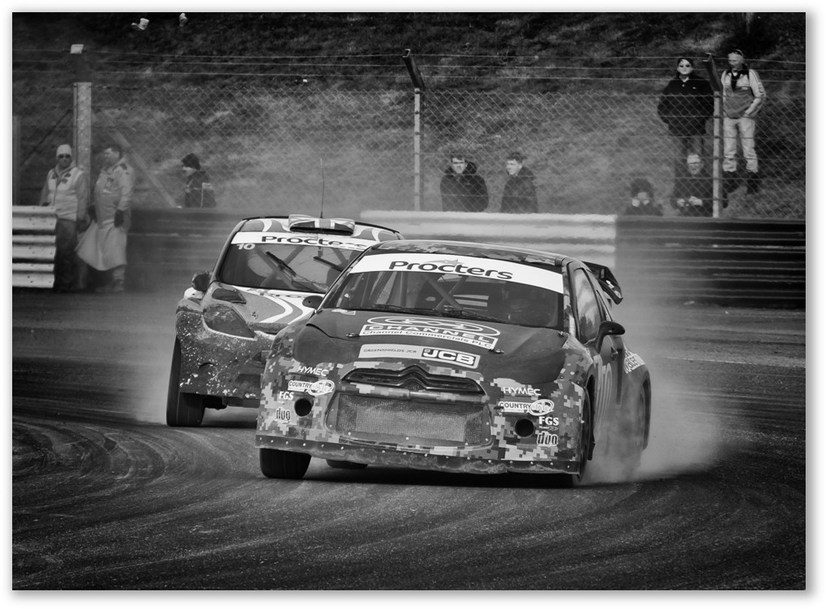
13 points
‘ Struggling’ – Michael Holliday

Slide 38
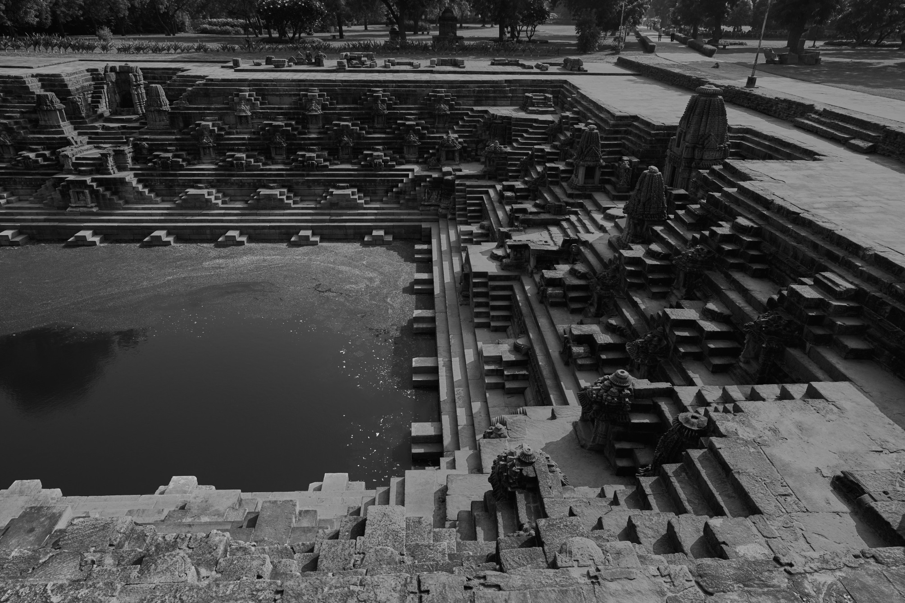
11 points
‘ Sun Temple Stepwell-1’ –Jim Kerr

Slide 39
12 points
‘ Sun Temple Stepwell-2’ – Jim Kerr

Slide 40
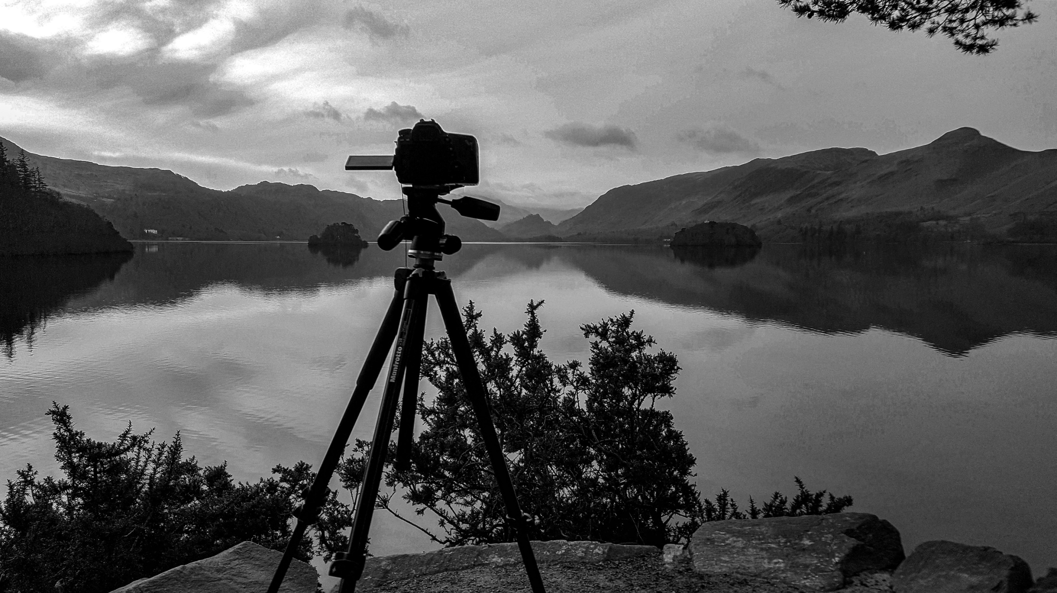
12 points
‘ The camera never lies’- David Bell

Slide 41
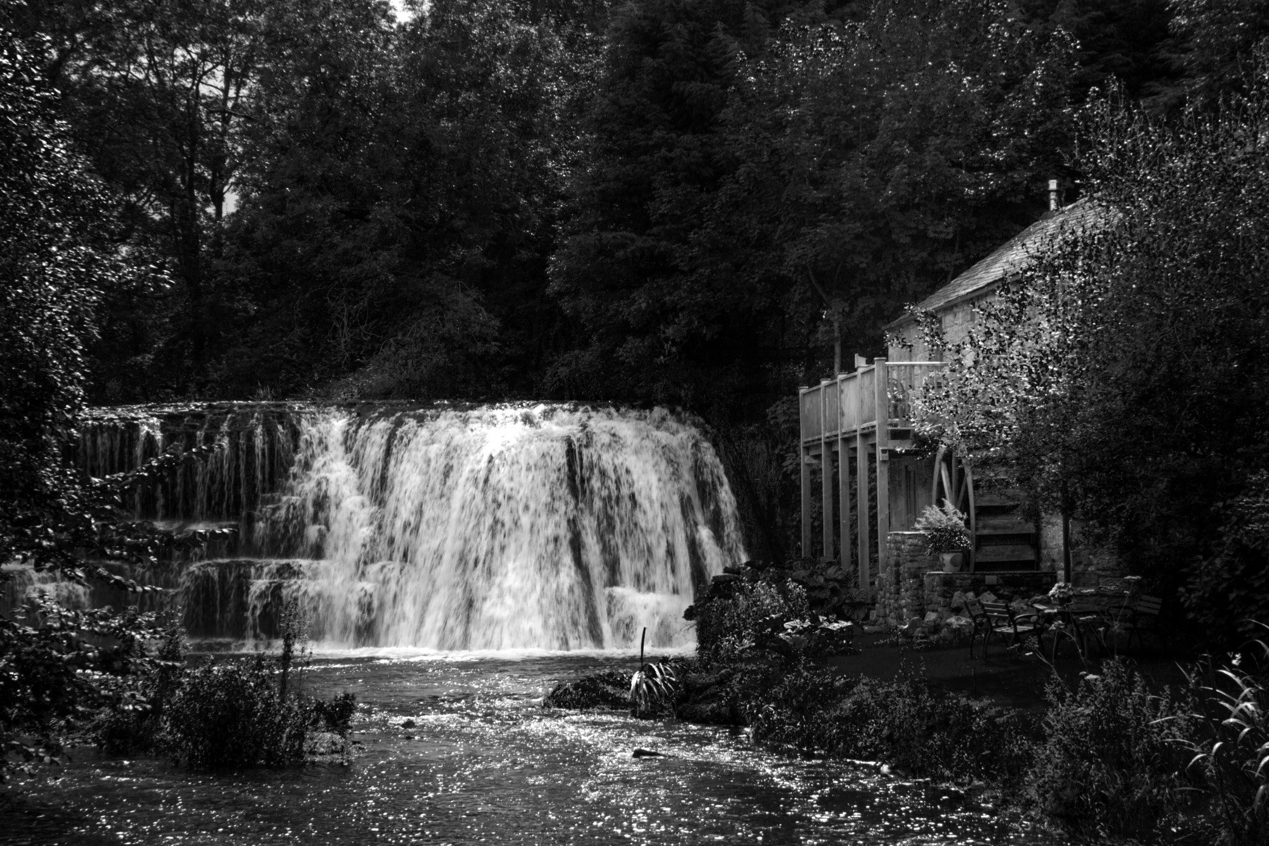
11 points
‘ The Old Mill’ – David Bell

Slide 42
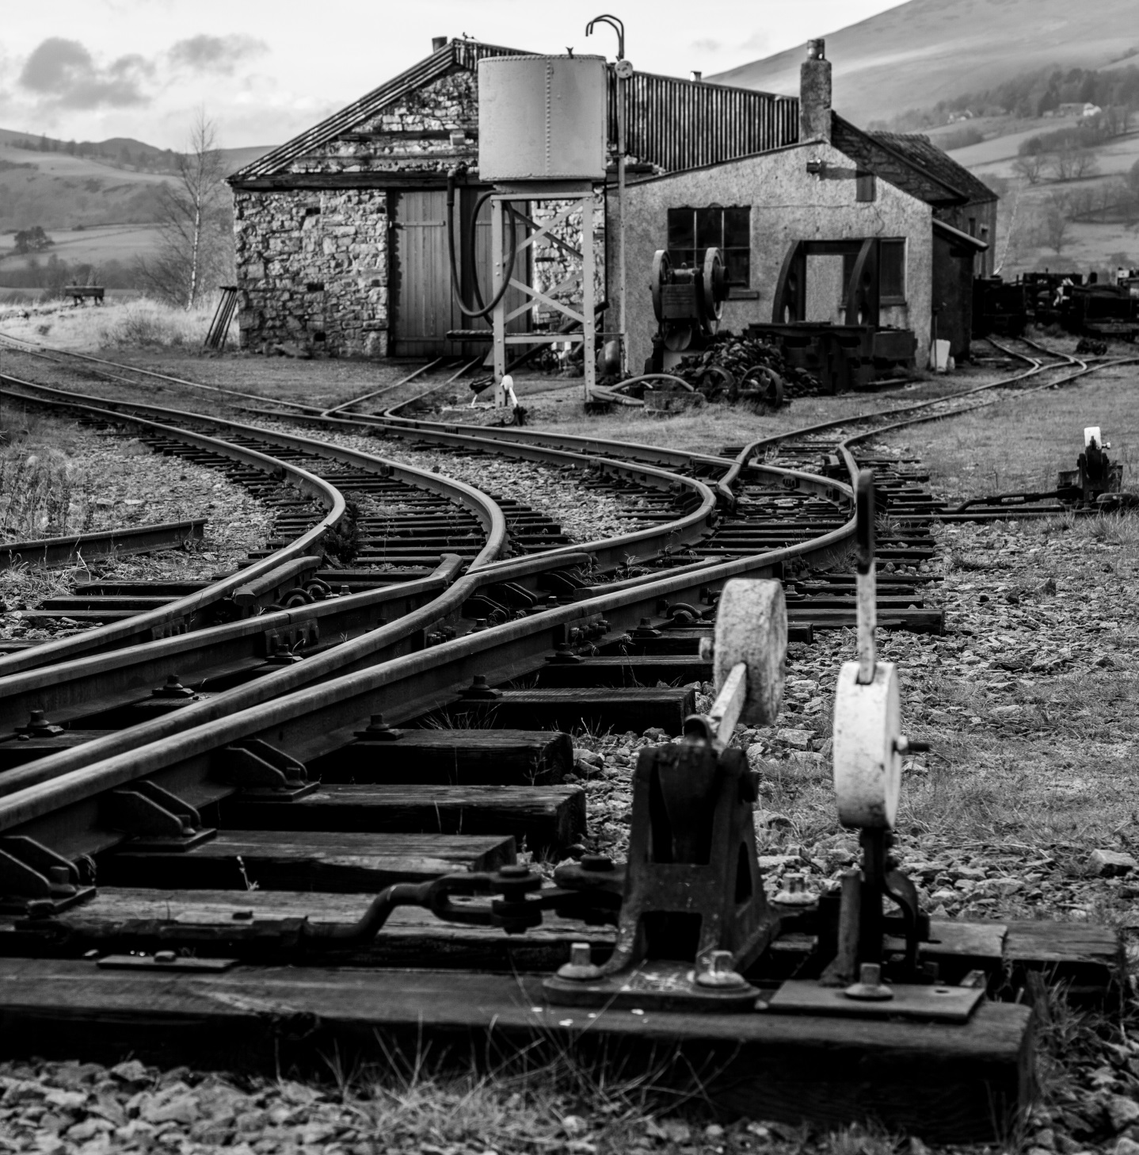
11 points
‘ Up the junction’ – Mike Childs

Slide 43
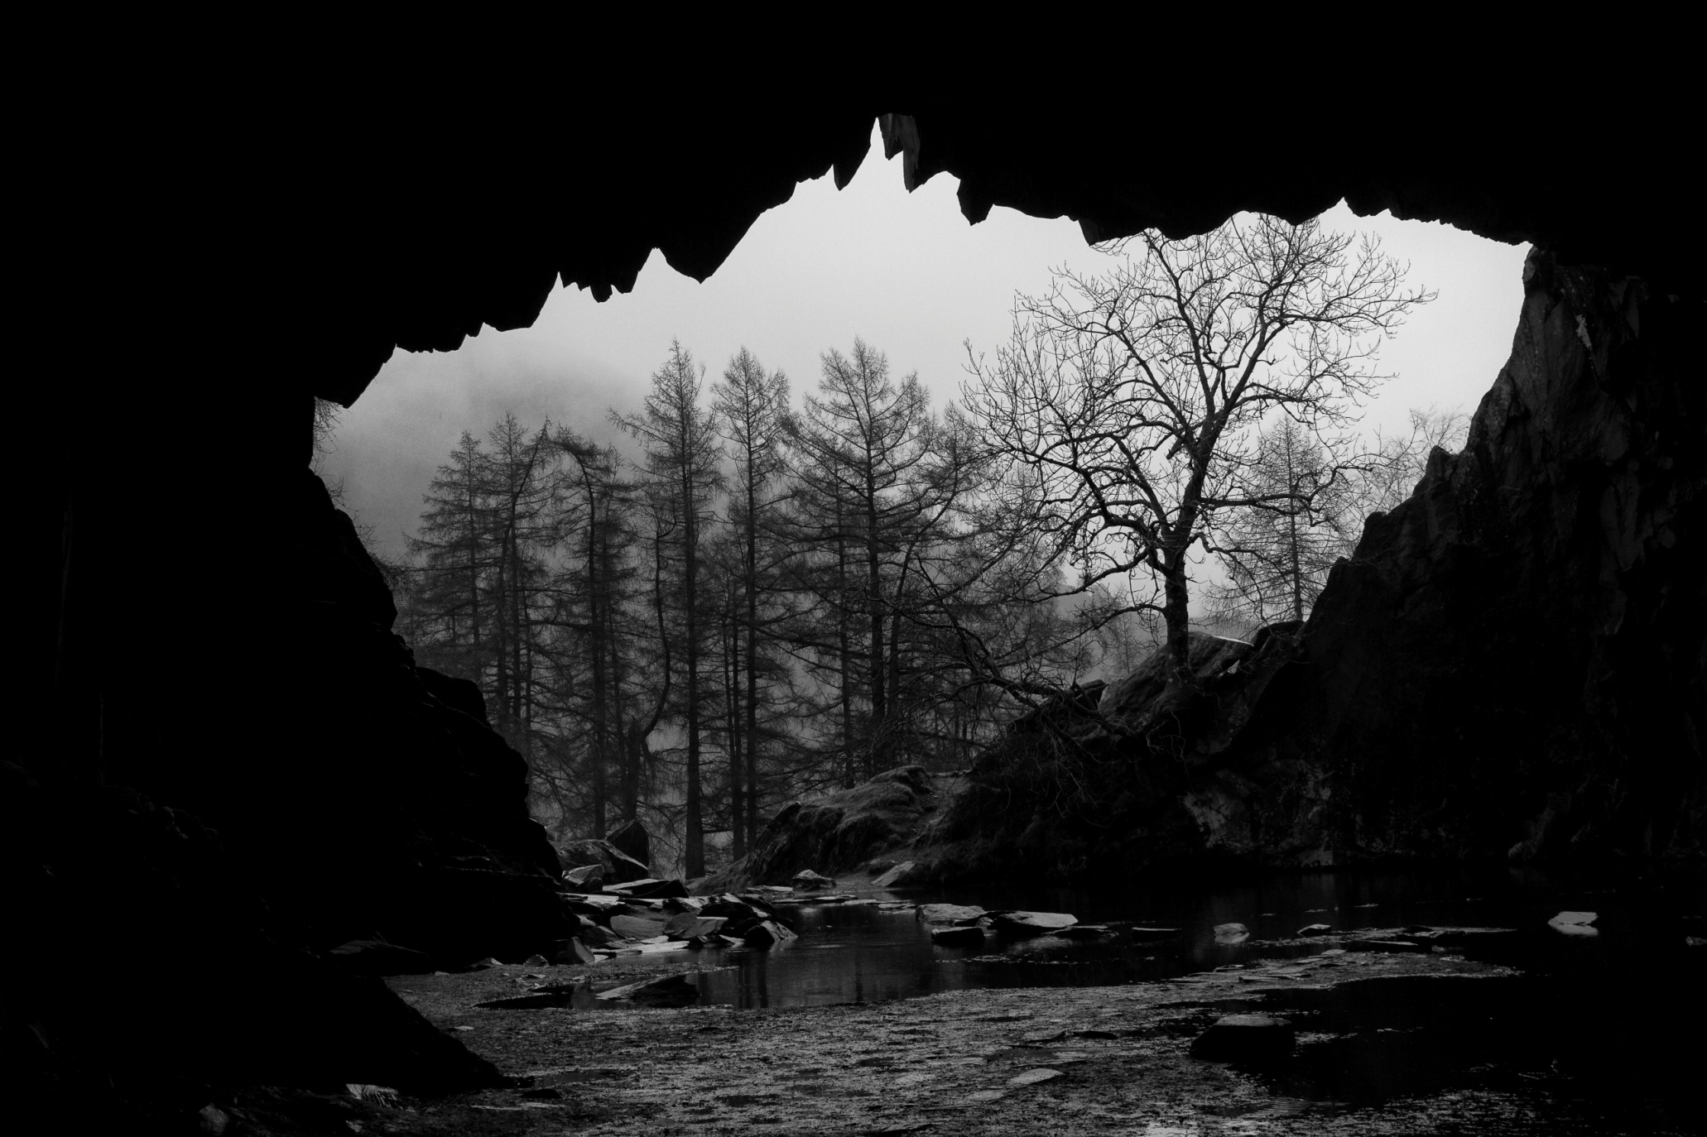
10 points
‘ View from within Rydal Caves’ – Jill Eastham

Slide 44
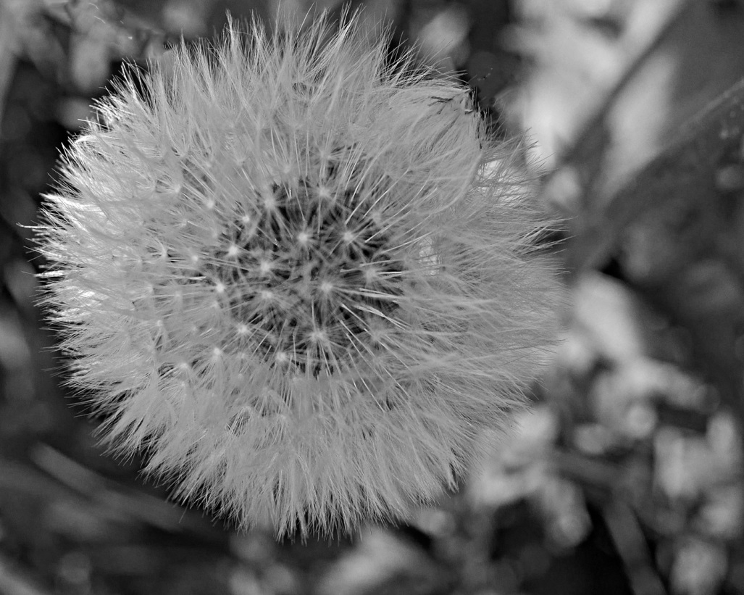
11 points
‘ Waiting for the Wind’ –Dennis Butterworth

Slide 45
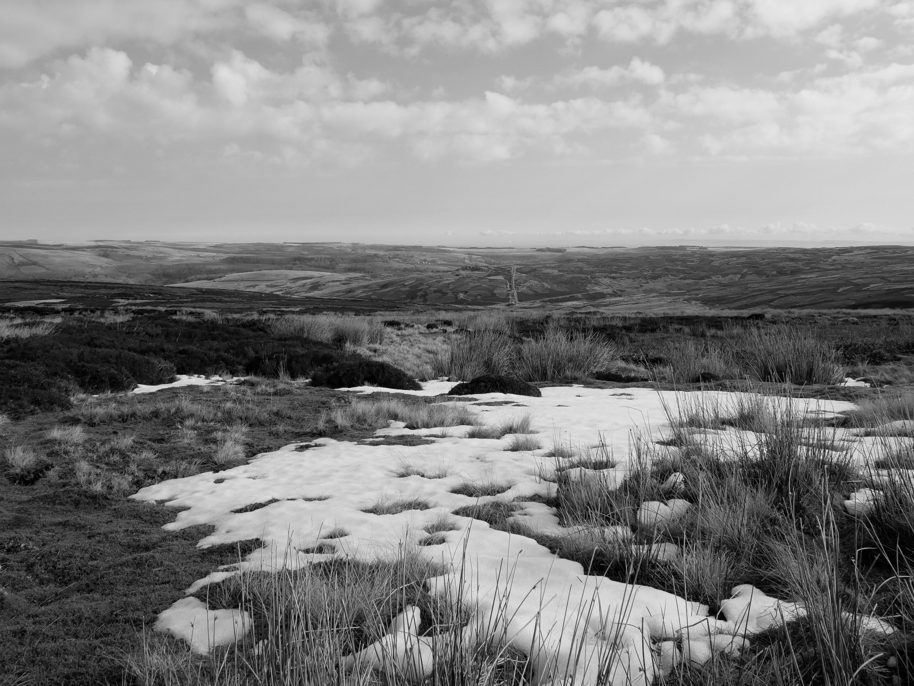
8 points
‘ Yorkshire Moor patchwork’ – Jacqueline Alexander

